Slide 1
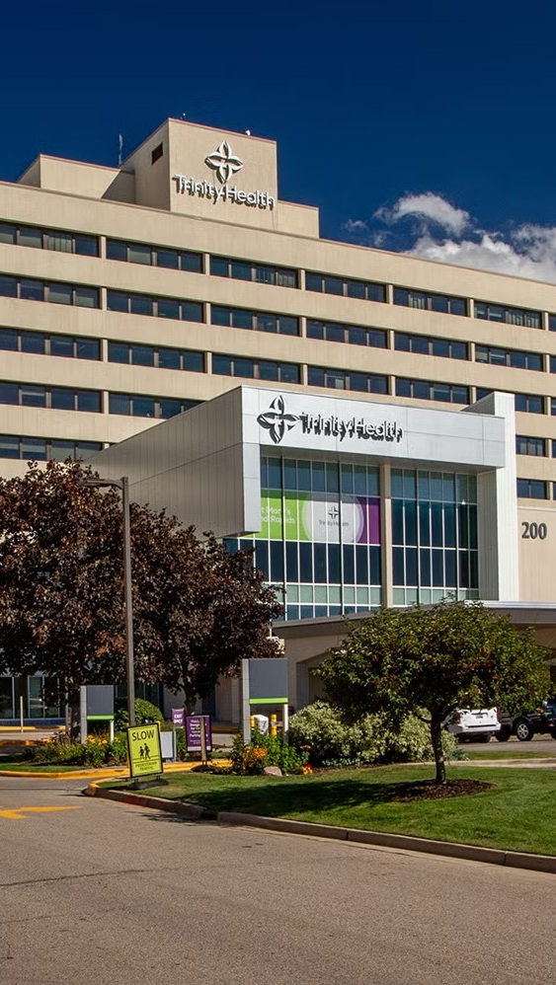


OPPORTUNITY REVIEW
DIRECT-TO-EMPLOYER GTM STRATEGY
Exploring a Trinity Health Michigan DTE Health Plan

Slide 2


Founded in 1979, headquartered in Indianapolis
Largest Independently-Owned Full-Service Third-Party Administrator
Specialize in Administration of Self-Funded Plans and Population Health Management​
Leader in the Direct-to-Employer Movement
We Know and Understand the Market
Experience Working with All Professional Teams: Agents, Networks, MGAs
The Key Family of Companies is a Vertically Integrated group of benefit related organizations
3,000+ Corporate Clients
3 Million Members under Management
700 Employees

Slide 3


MARKET LEADER
IN
PRIVATE LABELED
DTE PLANS
Louisville, KY
OneHealth Plan
Cincinnati, OH
TCH Optimal
Bentonville, AR
Northwest Health Plan
Knoxville, TN
East Tennessee Health Plan
Meridian, MS
Affinity Health Plan
Fort Myers, FL
Lee Health Care Partners

Slide 4
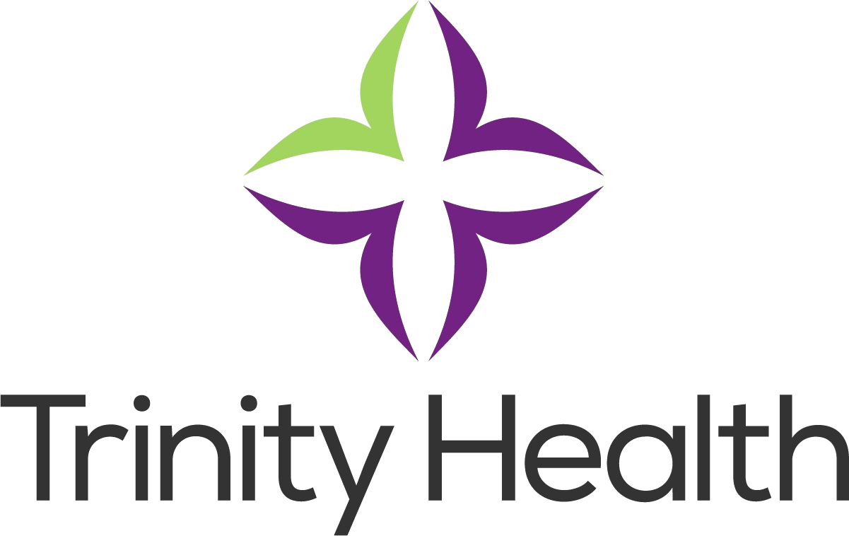

DIRECT-TO-EMPLOYER (DTE)
YOU Pick the Name of the Health Plan
YOU Determine the Fees Charged
YOU Practice the Medicine
YOU Receive the Profits
WE Make it Successful
Your Health Plan Focused on a Direct Relationship with Self-Funded Employers in Your Market

Slide 5

MODELING TRINITY HEALTH (MI) GO-TO-MARKET OPPORTUNITY
1
2
MODELING DEMAND
With over 10 years of experience, KBA has learned to accurately forecast plan growth, as a function of brand quality.
HCAHPS recommendation rates and competitive landscape are highly predictive of possible demand.
Trinity Health hospitals in MI have high variation in patient recommendation rates. Accordingly, some regions are far more likely to see growth.
MODELING PROFITABILITY
KBA models increased revenue coming from increased patient steerage.
To convert revenue growth to profit, KBA estimates high, medium and low estimates for net income based on (1) estimates of commercial margin and (2) the within-DTE-network steerage rate.

Slide 6
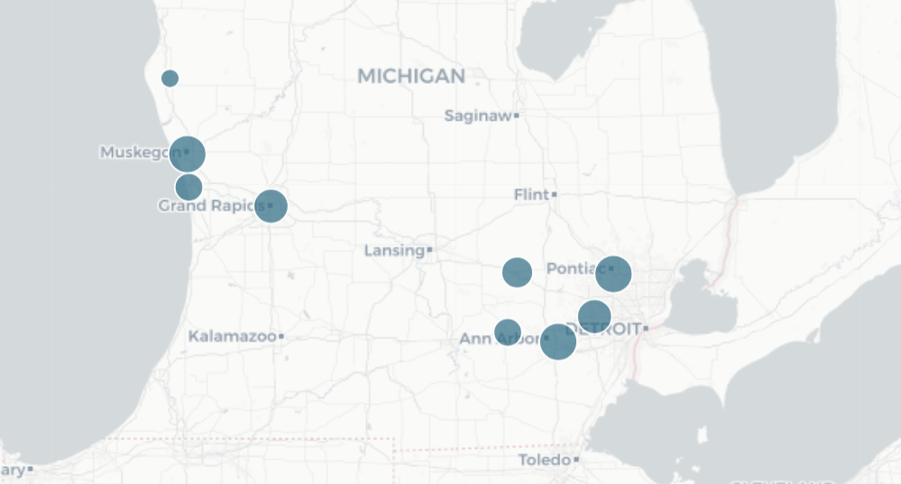
VARIATION IN PATIENT HCAHPS RECOMMENDATIONS National HCAHPS Patient Recommendation Percentile by Hospital
Shelby 78
Muskegon 24
KEY FINDING
KBA models that Ann Arbor and Grand Rapids would fuel growth for a Michigan-wide Trinity Health DTE plan.
Grand Rapids 78
Grand Haven 36
Livingston 61
Oakland 26
Chelsea 93
Livonia 33
Ann Arbor 78

Slide 7
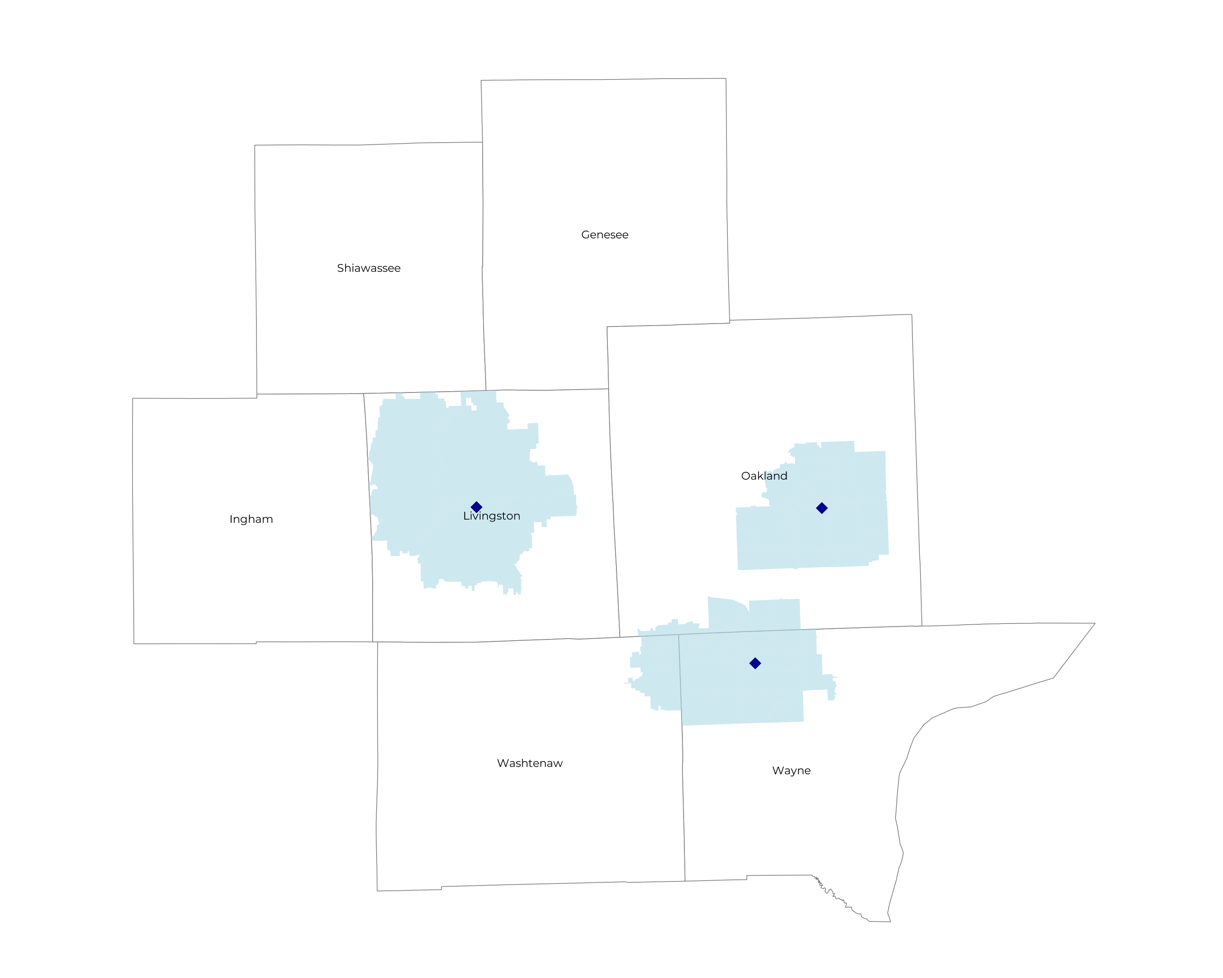
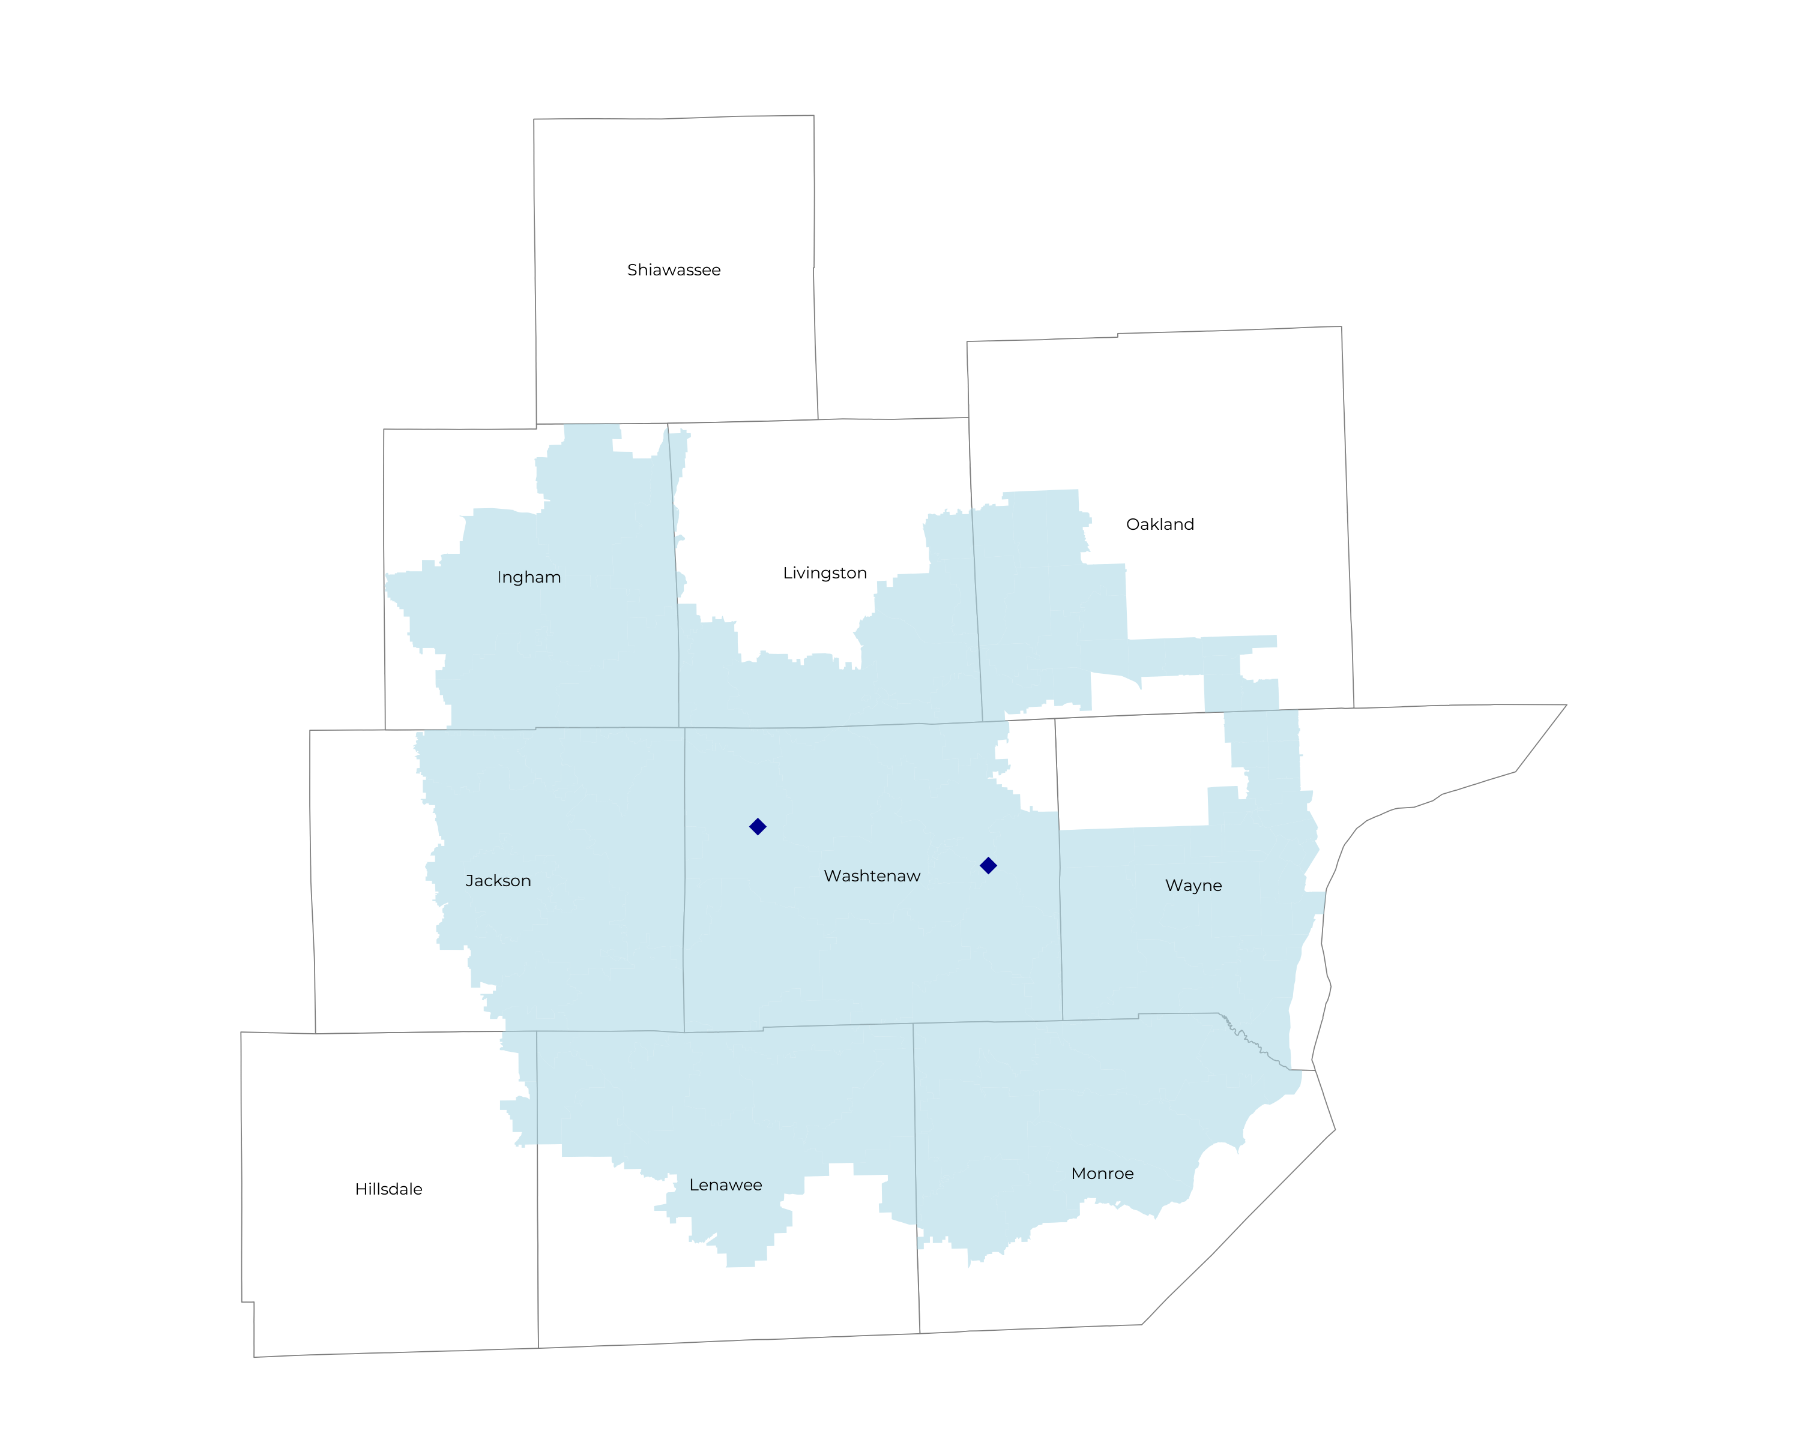
DETROIT/ANN ARBOR COMPETITIVE LANDSCAPE
Health System | HCAHPS Recommendation Percentile | KBA Brand Quality Score
University of Michigan Health | 89 | 74
Trinity Health (Ann Arbor and Chelsea) | 85 | 73
McLaren Health Care Corporation | 68 | 70
Department of Veterans Affairs | 60 | 66
Trinity Health (Combined) | 54 | 63
Ascension Health | 43 | 60
Henry Ford Health | 41 | 59
Trinity Health (Livingston, Oakland, Livonia) | 40 | 58
Corewell Health | 30 | 55
ProMedica Health System | 15 | 50
Tenet Healthcare | 3 | 46
Prime Healthcare Services | 5 | 45

Slide 8
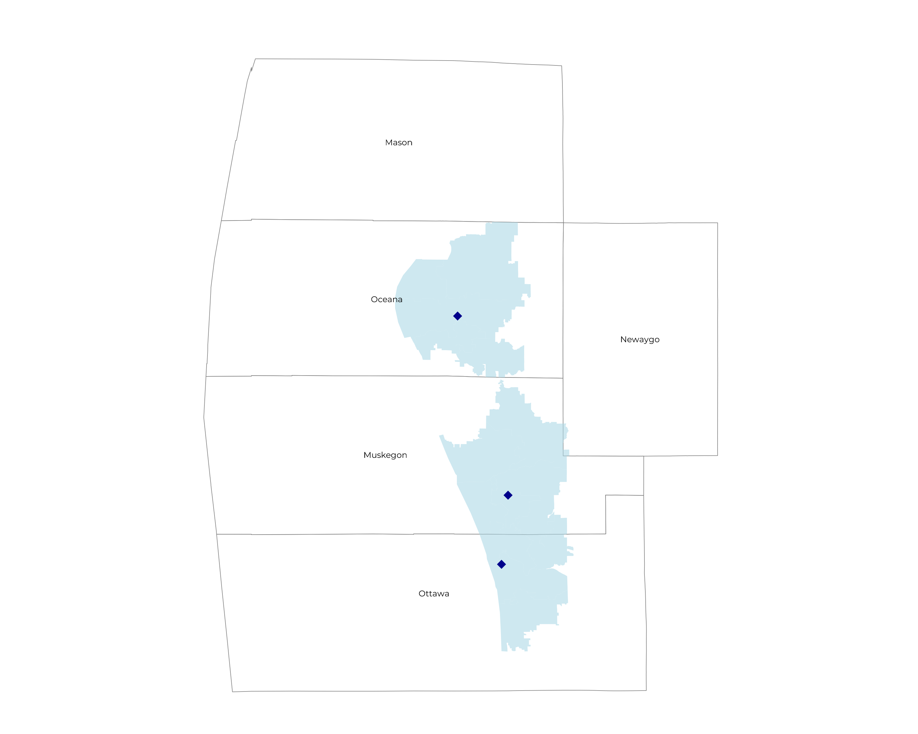
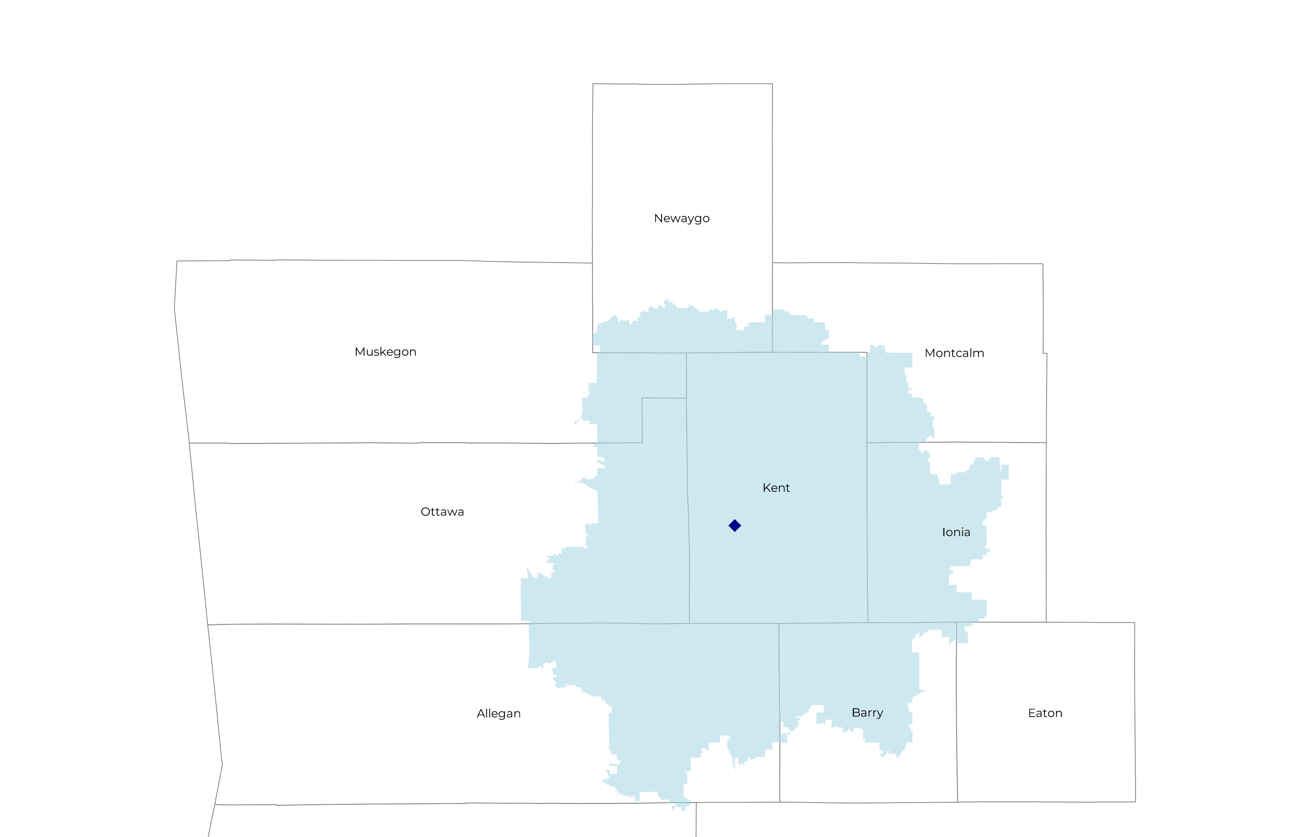
DETROIT/ANN ARBOR COMPETITIVE LANDSCAPE
Health System | HCAHPS Recommendation Percentile | KBA Brand Quality Score
Trinity Health Grand Rapids | 78 | 73
University of Michigan Health | 74 | 71
Other Independent Hospitals | 72 | 70
Corewell Health | 69 | 67
Trinity Health (All) | 58 | 64
Trinity Health Muskegon, Grand Haven and Shelby | 46 | 61

Slide 9
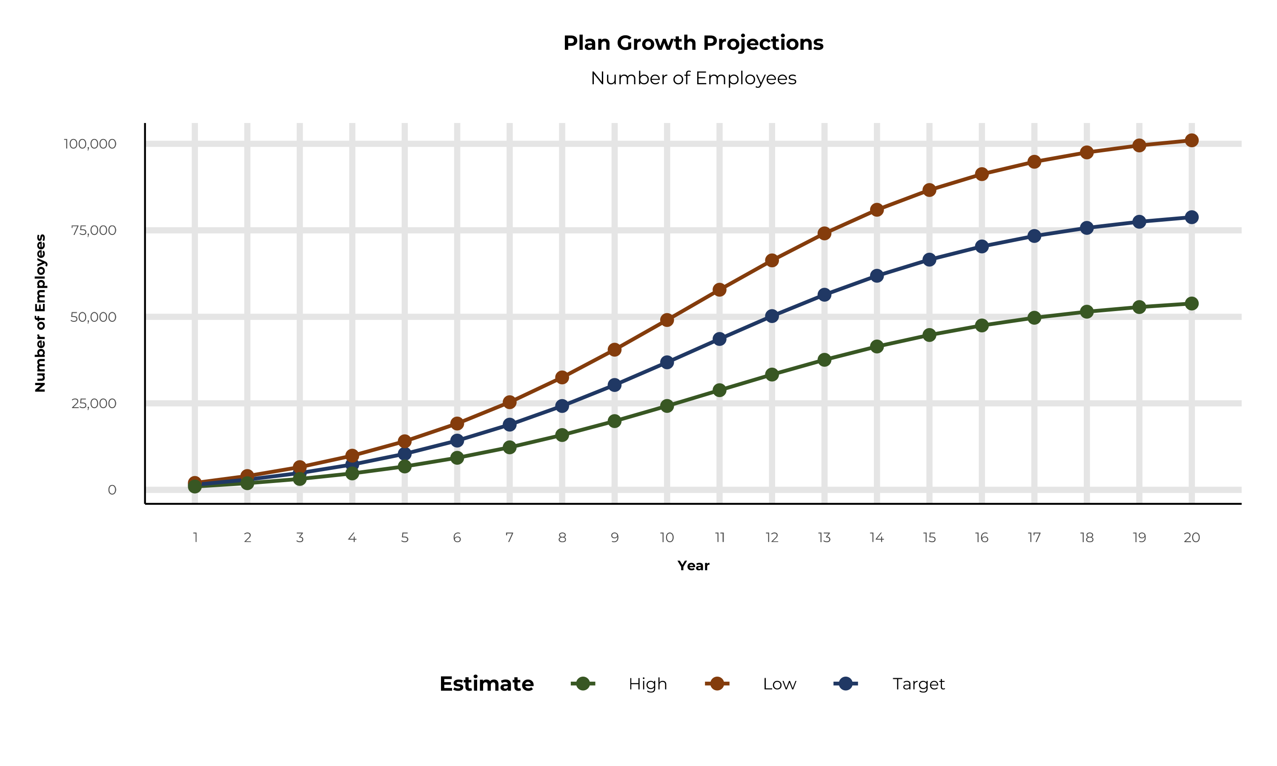
PLAN POTENTIAL GROWTH PATHS
Self Funded
1,428K
Insured
2,536K
Working Age
3,550K
Population
5,941K
Estimates includes the Trinity Health MI service area in Allegan, Barry, Genesee, Hillsdale, Ingham, Ionia, Jackson, Kent, Lapeer, Lenawee, Livingston, Macomb, Monroe, Montcalm, Muskegon, Newaygo, Oakland, Oceana, Ottawa, Shiawassee, Washtenaw, and Wayne Counties

Slide 10
ESTIMATED PLAN GROWTH BY REGION Forecasted Number of Employees in Direct-to-Employer Plans
Year | Grand Rapids | Muskegon, Grand Haven and Shelby | Oakland, Livonia, Livingston | Ann Arbor, Chelsea | Total Employees | Total Members | Percent of Members Choosing Trinity Health MI for Inpatient Care | Percent of Members Choosing Trinity Health MI for Outpatient Care
1 | 800 | 0 | 100 | 600 | 1,500 | 2,700 | 60% | 50%
2 | 1,500 | 0 | 100 | 1,300 | 2,900 | 5,400 | 60% | 50%
3 | 2,500 | 100 | 200 | 2,100 | 4,900 | 8,800 | 65% | 55%
4 | 3,800 | 100 | 300 | 3,100 | 7,300 | 13,100 | 67% | 58%
5 | 5,300 | 100 | 500 | 4,400 | 10,300 | 18,700 | 68% | 60%
6 | 7,300 | 200 | 700 | 6,100 | 14,300 | 25,600 | 68% | 60%
7 | 9,700 | 200 | 900 | 8,000 | 18,800 | 33,800 | 69% | 61%
8 | 12,400 | 300 | 1,100 | 10,300 | 24,100 | 43,600 | 69% | 62%
9 | 15,500 | 400 | 1,400 | 12,900 | 30,200 | 54,500 | 69% | 62%
10 | 18,900 | 400 | 1,700 | 15,700 | 36,700 | 66,400 | 70% | 63%
11 | 22,400 | 500 | 2,000 | 18,600 | 43,500 | 78,500 | 70% | 63%
12 | 25,800 | 600 | 2,300 | 21,400 | 50,100 | 90,400 | 70% | 64%
13 | 28,900 | 700 | 2,600 | 24,000 | 56,200 | 101,500 | 71% | 64%
14 | 31,700 | 700 | 2,800 | 26,400 | 61,600 | 111,400 | 71% | 65%
15 | 34,100 | 800 | 3,000 | 28,300 | 66,200 | 119,700 | 71% | 66%
16 | 36,100 | 800 | 3,200 | 30,000 | 70,100 | 126,500 | 72% | 66%
17 | 37,600 | 800 | 3,400 | 31,200 | 73,000 | 132,100 | 72% | 66%
18 | 38,800 | 900 | 3,500 | 32,200 | 75,400 | 136,300 | 72% | 67%
19 | 39,700 | 900 | 3,600 | 33,000 | 77,200 | 139,500 | 72% | 67%
20 | 40,400 | 900 | 3,600 | 33,600 | 78,500 | 141,800 | 72% | 67%
KBA currently estimates that Trinity Health MI has 11% inpatient market share, and 8% outpatient market compared to hospitals/clinics in the Trinity Health service area.
Based on previous DTE experience, KBA expects a significant bump in patient steerage to Trinity Health.
Additional steerage will occur from additional steerage patient benefits and the patient card.
High estimates start nearly 10% higher than target with low estimates at 10% lower than target

Slide 11
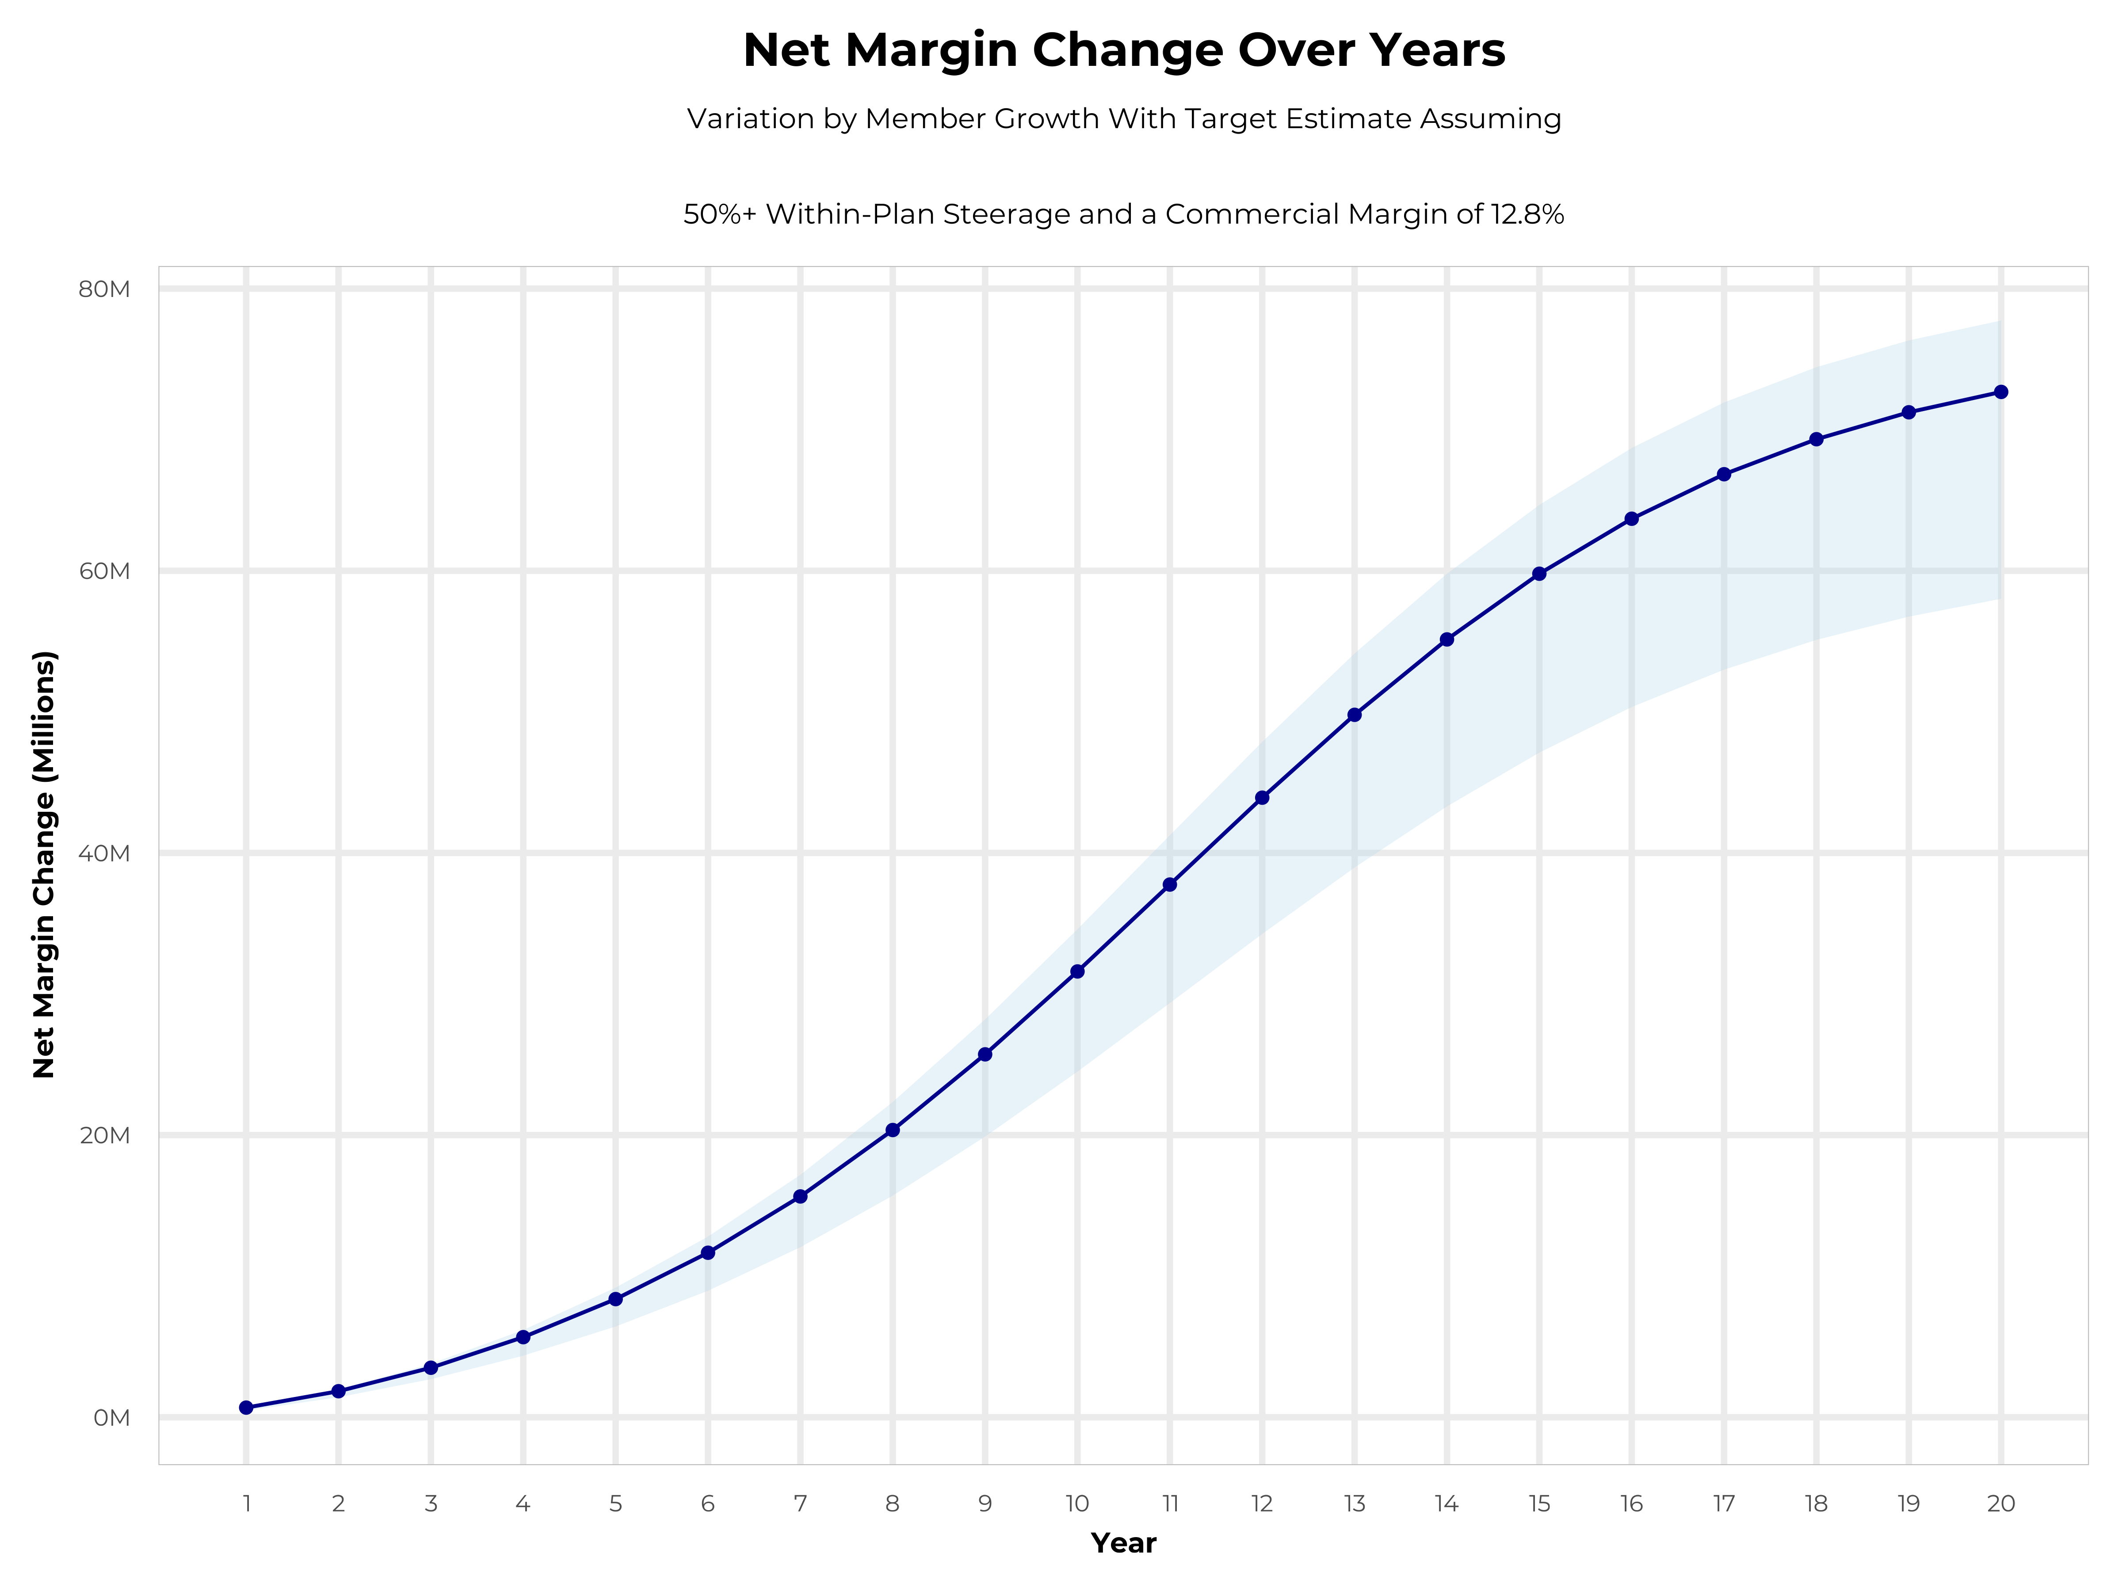
GROWING POWERFUL, LASTING PROFITABILITY
Early Stage
Gaining Name Recognition, Early Growth
New Revenue:
New Profit:
$44.43M
$5.29M
Growth Stage
Strong Reputation, Strong Growth
New Revenue:
New Profit:
$261.67M
$32.11M
Mature Stage
High Profitability, Market Saturation
New Revenue:
New Profit:
$533.16M
$65.53M

Slide 12
JOINT INVESTMENT FRAMEWORK
Plan Set-Up Fees
Plan and network creation, registration, marketing, sales, branding and launch.
Yearly Sales Fees
Two dedicated sales leaders and ongoing sales/marketing support.
Network Total Launch Cost | $310K+
Trinity Launch Costs | $150K
Trinity Health Rebate | $37.5K per 1,500 employee lives added to the plan, up to a maximum of 4,500 employee lives –potential rebate of $112.5K
KBA Launch Costs | 160-272.5K (depending on rebate)
Network Total Annual Sales, Marketing and Administration Costs | $380K+
Trinity Health Yearly Investment | $180K
KBA Yearly Investment | 200K
Trinity Health launch costs cover the employer marketing campaign, the stop-loss relationship campaign, and employer communication campaigns.
KBA’s yearly investment covers three full-time implementation specialists, a PMI-certified project manager, expanded leadership support, claims administration programming, training and auditing, legal and regulatory compliance review, and provider network creation and management..
Trinity Health’s sales and marketing costs cover local sales leader salary and benefits.
KBA’s yearly investment covers sales leadership, marketing, broker and partner communications, website management, promotions, network management, patient convenience cards, Key Incentive Plan administration, EHR integration, promotional materials, and administrative reporting.

Slide 13
DIRECT-TO-EMPLOYER STRATEGY: ONLY AVAILABLE TO PREMIER HEALTH SYSTEMS
STRONG Brand Quality
EXTENSIVE Patient Access
AFFORDABLE Value Pricing
EXCELLENT Care Quality

Slide 14

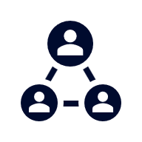



A PARTNER YOU CAN TRUST
OUR OBJECTIVES ARE ALIGNED
WE KNOW THE
MARKET
COMPLETELY TRANSPARENT
WE HAVE THE SOPHISTICATION AND INFRASTRUCTURE TO EFFECTIVELY COMPETE
Derek Moore, Senior Vice President – KBA
845-283-9973 * derek.moore@keybenefit.com

